Slide 1

Session 4 - Introduction to APIs Foundations of Python for Data Science
Gaurav Bhardwaj, Kristoffer Bjärkefur, Wei Lu, Robert Marty, Luis Eduardo San Martin
The World Bank | WB GitHub
December 2023

Slide 2
What is an API? (Application Programming Interface)

Slide 3






restaurant.com
I am a chef and I have plenty off food to offer
I am hungry and I want some food

Slide 4





restaurant.com
Guests
What guests must use to get stuff
Stuff guest wants

Slide 5
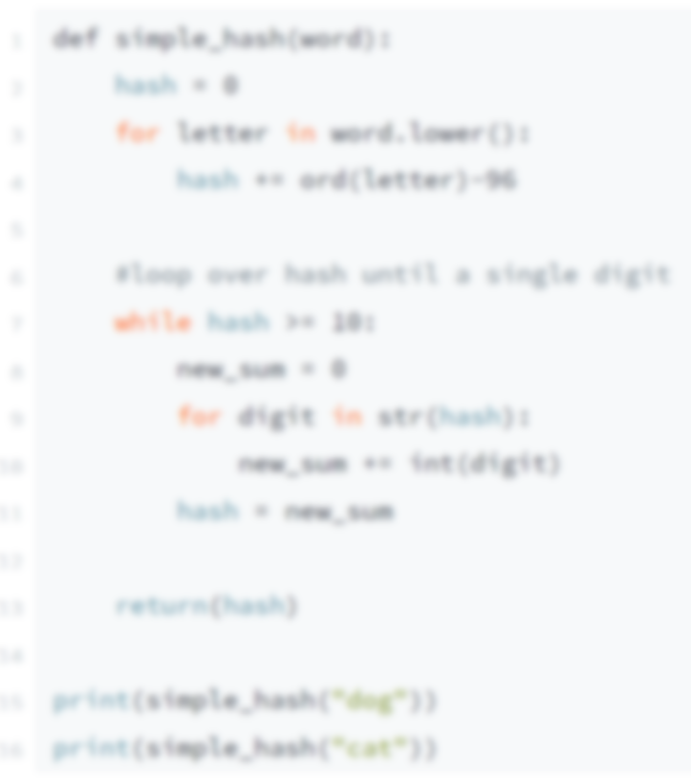

restaurant.com
Clients
Application Programming Interface
API
Resources
restaurant.com/api/host/gettable
restaurant.com/api/host/reservation
restaurant.com/api/waiter/food
restaurant.com/api/waiter/drink
restaurant.com/api/sommelier/wine
restaurant.com/api/manager/pay
restaurant.com/api/manager/complain

Slide 6
Application Programming Interfaces (APIs)
An API is a channel to interact with a web server
In data science, these interactions are mostly used to retrieve data from data bases

Slide 7
Application Programming Interfaces (APIs)
Why an API?
Allows to access data programmatically
No more sharing data and code for a project, only code
Allows to run code on the most recent data available

Slide 8
Application Programming Interfaces (APIs)
How to use an API
Read the API documentation
Find the API endpoint
Explore the endpoint
Start by trying a simple query in your web browser
Explore the API result
JSON is a widely used data format. It consists of nested dictionaries and lists
Write code to send custom API requests

Slide 9
API Example 1: http://open-notify.org/
A very simple API to get real time data about the International Space Station
You can find the documentation here: http://open-notify.org
Two endpoints:
Current location of the ISS: http://api.open-notify.org/iss-now.json
Astronauts in space now: http://api.open-notify.org/astros.json

Slide 10
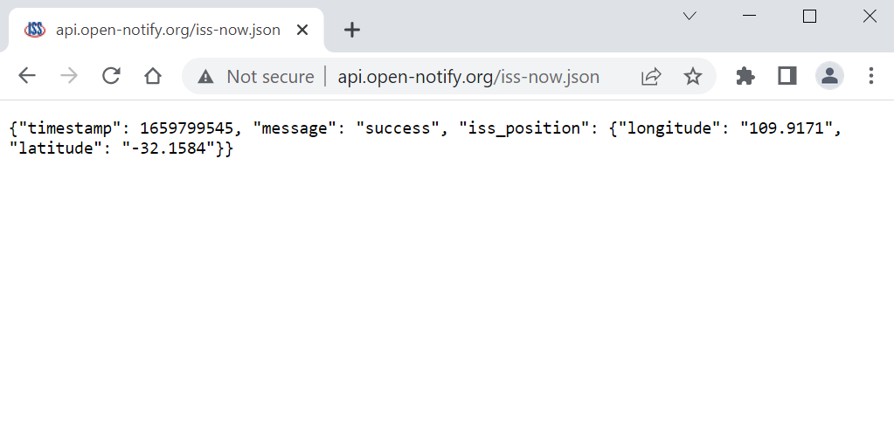
API Example 1: http://open-notify.org/

Slide 11
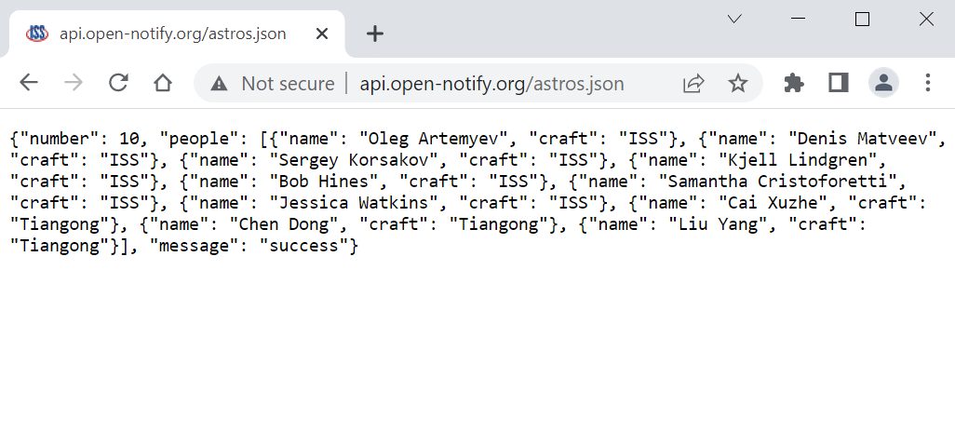
API Example 1: http://open-notify.org/

Slide 12
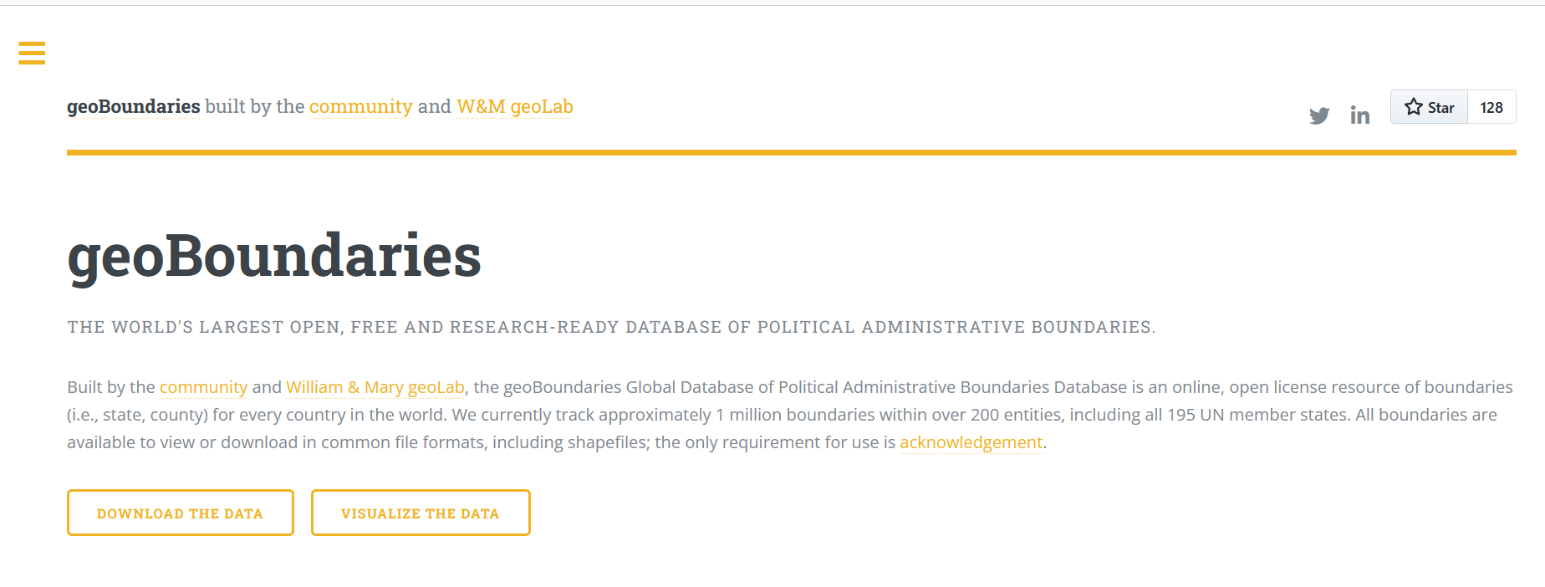
API Example 2: https://www.geoboundaries.org/
API to fetch geographic country data.
Documentation: https://www.geoboundaries.org/api.html

Slide 13
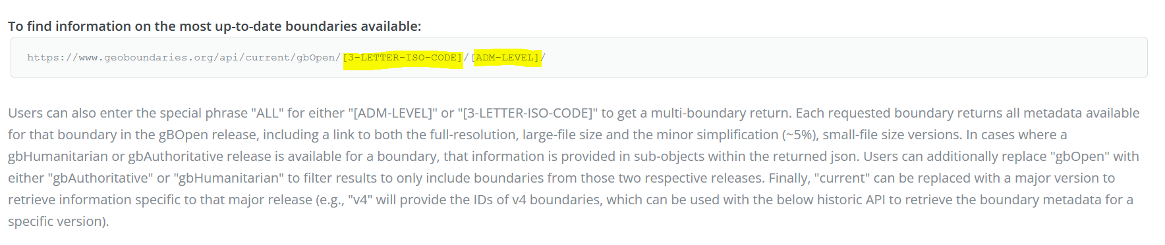
API Example 2: https://www.geoboundaries.org/
From the documentation:

Slide 14
Custom API calls
Most APIs require users to pass information through the URL to specify how they want to interact with the web server.
Examples:
Colombia national boundaries: https://www.geoboundaries.org/api/current/gbOpen/COL/ADM0/
Pakistan first-level administrative boundaries: https://www.geoboundaries.org/api/current/gbOpen/PAK/ADM1/

Slide 15
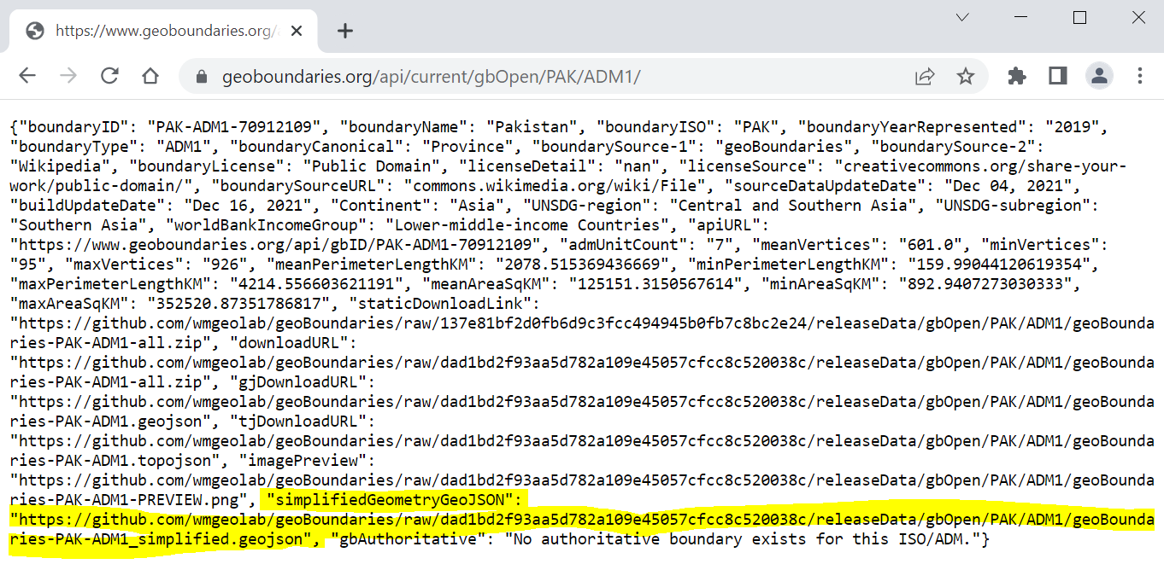
Exploring API results
Many APIs will return extra information and metadata we don’t always need
You should explore the returning JSON to locate relevant information and data

Slide 16
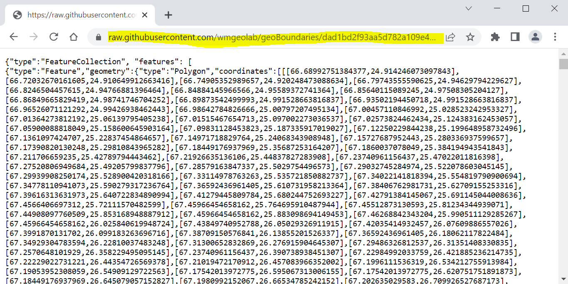
Exploring API results

Slide 17
Now we’ll continue with the notebooks for this session Thank you! Gracias!

